Slide 1
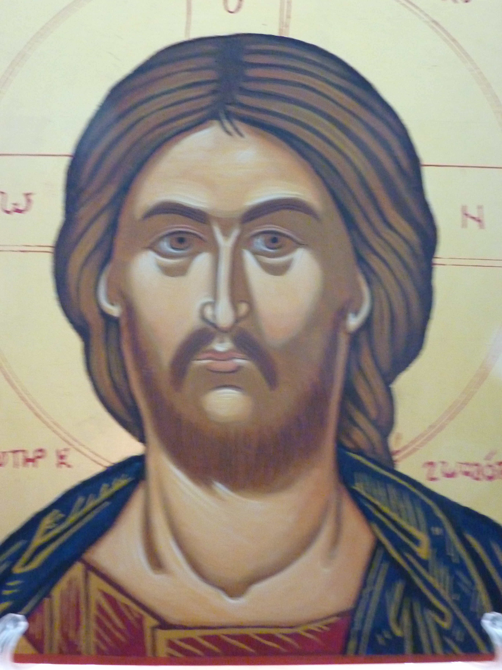
The Beatitudes: A Radical Way of Living

Slide 2
Sources for this presentation The Beatitudes of Pope Francis A Manifesto for the Modern Christian by Aidan Donaldson The Wisdom Jesus Transforming Heart and Mind – a New Perspective on Christ and His Message by Cynthia Bourgeault

Slide 3
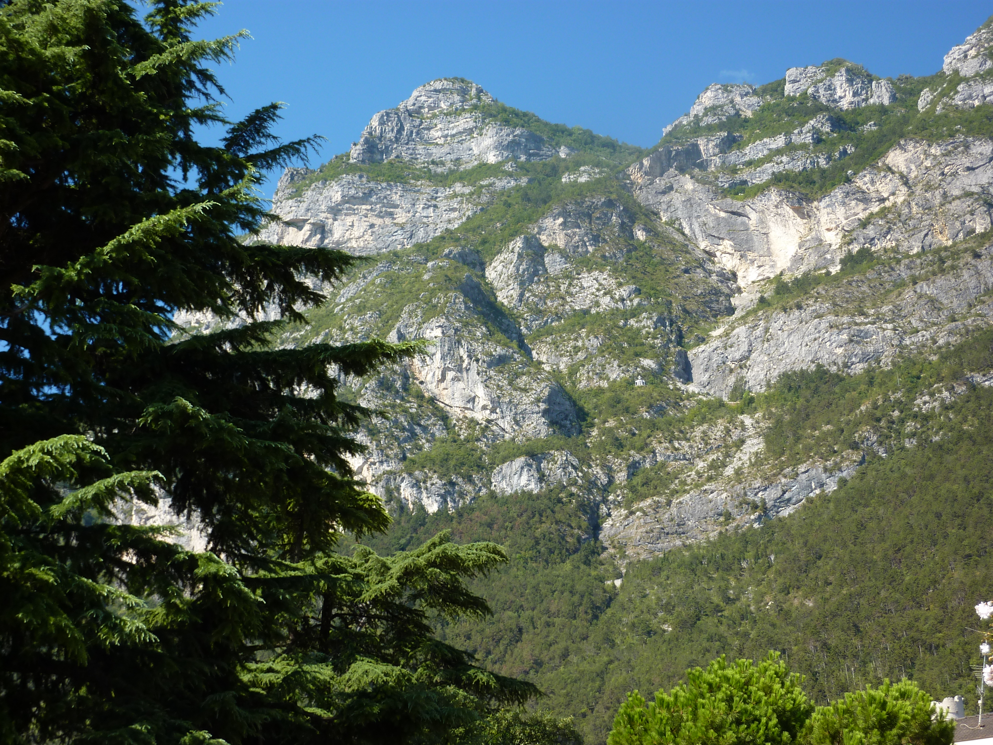
Now when Jesus saw the crowds, he went up on a mountainside and sat down. His disciples came to him, and he began to teach them.

Slide 4
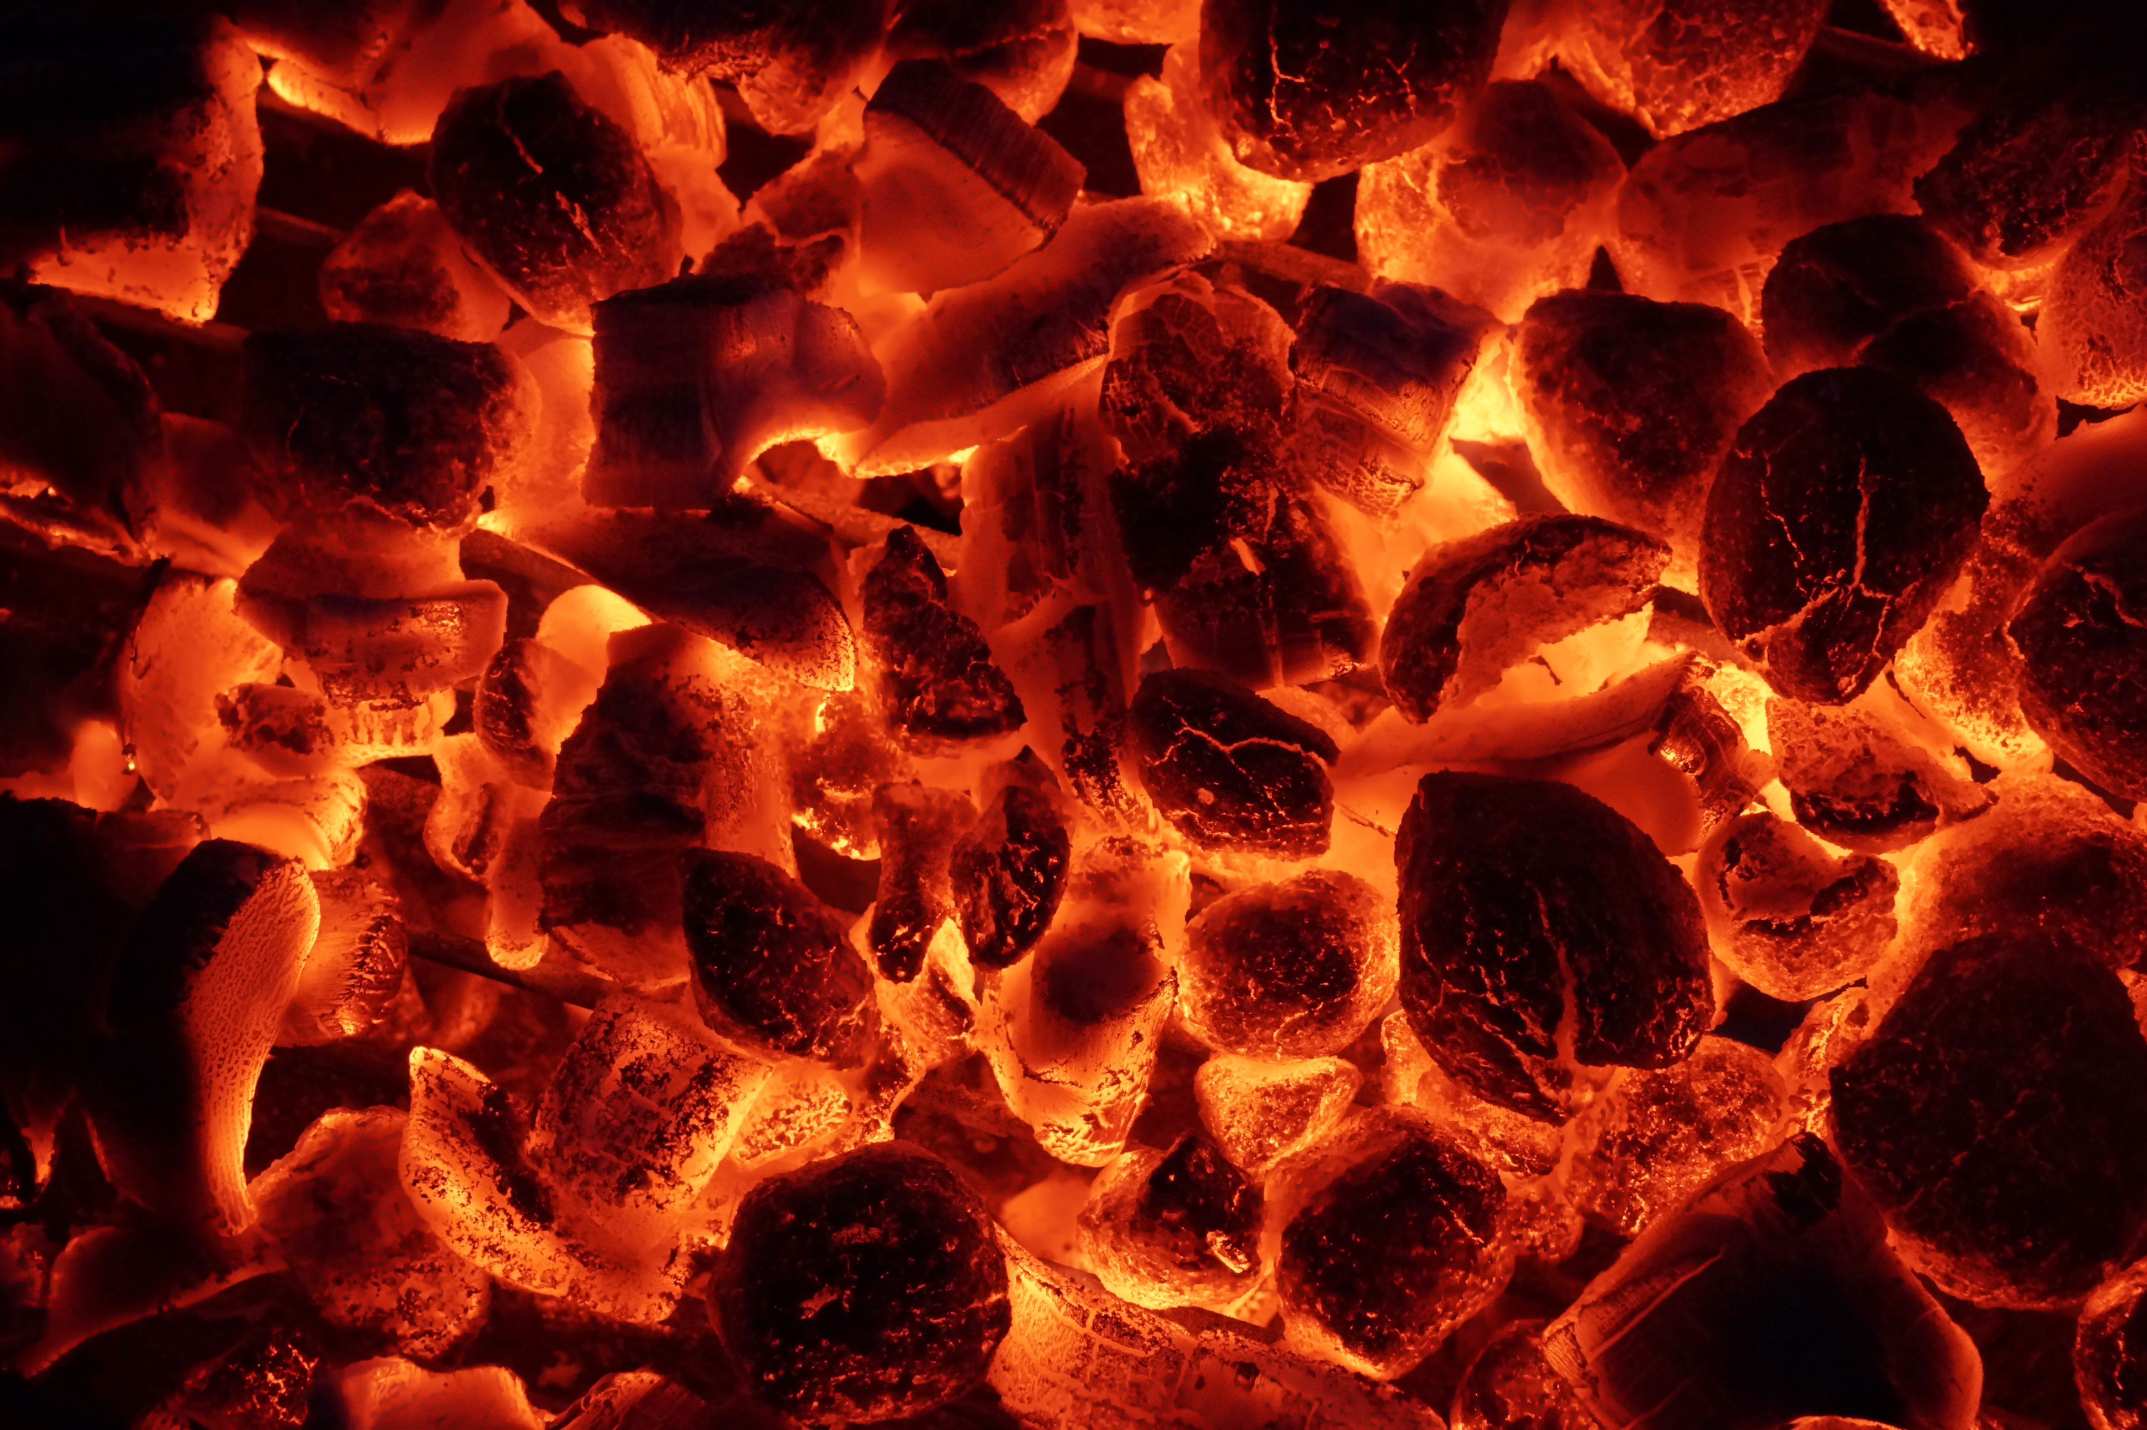
Moses and the Burning Bush On sacred ground
Later given the Tablets of Stone
to bond the People of Israel
Moses came down from the mountain, found the people had created an idol and the tablets were smashed
Jesus expects much more than the commandments.

Slide 5
The poor in spirit, Those who mourn, The meek, Those who hunger and thirst for righteousness, The merciful, The pure in heart Peacemakers, Persecuted When people insult you,

Slide 6
Blessed are the poor in spirit for theirs is the kingdom of heaven
Those in poor spirits who suffer from all kinds of stress, distress and disorders: people with demons, epileptics and paralytics (cf Mt.4:24)
Unattached/ Free. Jesus (2 Cor.8:9)
(Phil.2:6) Security is in God
Your photo or illustration ?

Slide 7
The scriptures and the poor in spirit.
2 Corinthians 8:9
For you know the grace of our Lord Jesus Christ, that though he was rich, yet for your sake he became poor, so that you through his poverty might become rich.
Philipians 2:6-7
In your relationships with one another, have the same mindset as Christ Jesus:
Who, being in very nature^{[a]} God, did not consider equality with God something to be used to his own advantage;
rather, he made himself nothing by taking the very nature^{[b]} of a servant, being made in human likeness. And being found in appearance as a man, he humbled himself by becoming obedient to death— even death on a cross!

Slide 8
Blessed are those who mourn for they will be comforted
Those who mourned were those who cried aloud in the streets and were totally destitute and abandoned. They included widows, orphans, exploited labourers and the poorest of the poor: Blind Bartimaeus (Mk.10:46ff), the beggar Lazarus (Lk.16:19ff), the lepers (Lk.17:11ff), the possessed man in Gadara (Mt.8:28ff).
Mourn broken relationships, live in fear of the Lord. Can trust and let go. (cf Rom.12:15)
Your photo or illustration ?

Slide 9
The scriptures and those who mourn
Romans 12. 15-16
Rejoice with those who rejoice; mourn with those who mourn. Live in harmony with one another.

Slide 10
Blessed are the meek for they will inherit the earth
The meek are the powerless and the voiceless, the unseen and the unheard. They are the people who stay out of sight. Jesus was meek in that he saw himself as one who came to serve rather than be served. (Mt.20:28)
The meek do not try to control or dominate. Jesus promises rest and light burdens. (Mt.11:28)
Your photo or illustration ?

Slide 11
The scriptures and those who are meek .
Matthew 11:28-30
“Come to me, all you who are weary and burdened, and I will give you rest. ²⁹ Take my yoke upon you and learn from me, for I am gentle and humble in heart, and you will find rest for your souls. ³⁰ For my yoke is easy and my burden is light.”

Slide 12
Blessed are those who hunger and thirst for righteousness for they will be filled
They live in accordance with the commandments and the law. (cf Is 1:17) They live in right relationship with themselves, with God and with their neighbour. (Mt.22:37ff) They seek to restore broken relationships.
They really long for justice in the world especially for the defenseless orphan and widow. (Is 1.17) They show strength and courage.
Your photo or illustration ?

Slide 13
The scriptures and those who hunger and thirst for righteousness.
Isaiah 1.17-18
Learn to do right; seek justice. Defend the oppressed.^{[a]} Take up the cause of the fatherless; plead the case of the widow.
“Come now, let us settle the matter,” says the Lord. “Though your sins are like scarlet, they shall be as white as snow; though they are red as crimson, they shall be like wool.

Slide 14
Blessed are the merciful for they will be shown mercy
The merciful are those who do not judge. (Lk 6:36-38) They forgive the wrongs done to them. They love their enemies. (Mt 7:1-5) Jesus refused to condemn the woman accused of adultery and from the cross forgave those who had him crucified. (Lk 23:24)
The merciful are those who show compassion and solidarity with those who are walked over and underprivileged
Your photo or illustration ?

Slide 15
Those who are merciful and show mercy in the Scriptures
The Parable of the Wicket Servant
Then the master called the servant in. ‘You wicked servant,’ he said, ‘I cancelled all that debt of yours because you begged me to. Shouldn’t you have had mercy on your fellow servant just as I had on you?’ In anger his master handed him over to the jailers to be tortured, until he should pay back all he owed.
“This is how my heavenly Father will treat each of you unless you forgive your brother or sister from your heart.”

Slide 16
Blessed are the pure of heart for they will see God
The pure in heart are those who are without guilt or blame. They are innocent and clean of heart. Jesus freed people from ”unclean spirits” and cured the lepers and made them clean. (cf Mt.6:6)
The pure in heart possess a singleness of purpose and desire one thing only – to focus their lives on God.
Your photo or illustration ?

Slide 17
The scriptures and those who are pure in heart.
At the Home of Mary and Martha
As Jesus and his disciples were on their way, he came to a village where a woman named Martha opened her home to him. ³⁹ She had a sister called Mary, who sat at the Lord’s feet listening to what he said. ⁴⁰ But Martha was distracted by all the preparations that had to be made. She came to him and asked, “Lord, don’t you care that my sister has left me to do the work by myself? Tell her to help me!”
⁴¹ “Martha, Martha,” the Lord answered, “you are worried and upset about many things, ⁴² but few things are needed—or indeed only one.^{[f]} Mary has chosen what is better, and it will not be taken away from her.”

Slide 18
Blessed are the peacemakers for they will be called children of God
Peacemakers recognize that the causes of injustice are complex and ingrained and they have to be prepared to face down oppressive structures. This is often a very dangerous path to take and demands courage, conviction and resilience. (cf Rom. 14:19)
Peace makers are not just peace lovers. Peace making Involves risk, compassionate listening and creative vision.
Your photo or illustration ?

Slide 19
The scriptures and those who are peacemakers.
Peacemakers
Peacemakers who sow in peace reap a harvest of righteousness.
(James)
But when you pray, go into your room, close the door and pray to your Father, who is unseen. Then your Father, who sees what is done in secret, will reward you. (Mt.6:6)

Slide 20
Blessed are those who are persecuted because of righteousness for theirs is the kingdom of heaven
There is no such thing as “cheap grace” said Dietrich Bonhoeffer. We should examine carefully where criticism of us comes from. Where are the vested interests? You (in the singular) must be prepared to embrace suffering. (cf Mt.16.25)
Do not take things personally. Wisdom does not understand imprisonment says Thomas Merton.
Your photo or illustration ?

Slide 21
The scriptures and those who are persecuted.
Jesus on the Cross
Jesus said, “Father, forgive them, for they do not know what they are
doing.” And they divided up his clothes by casting lots.
(Luke 23:34)

Slide 22
Blessed are you when people insult you, persecute you and falsely say all kinds of evil against you because of me.
Rejoice and be glad, because great is your reward in heaven, for in the same way they persecuted the prophets who were before you.

Slide 23
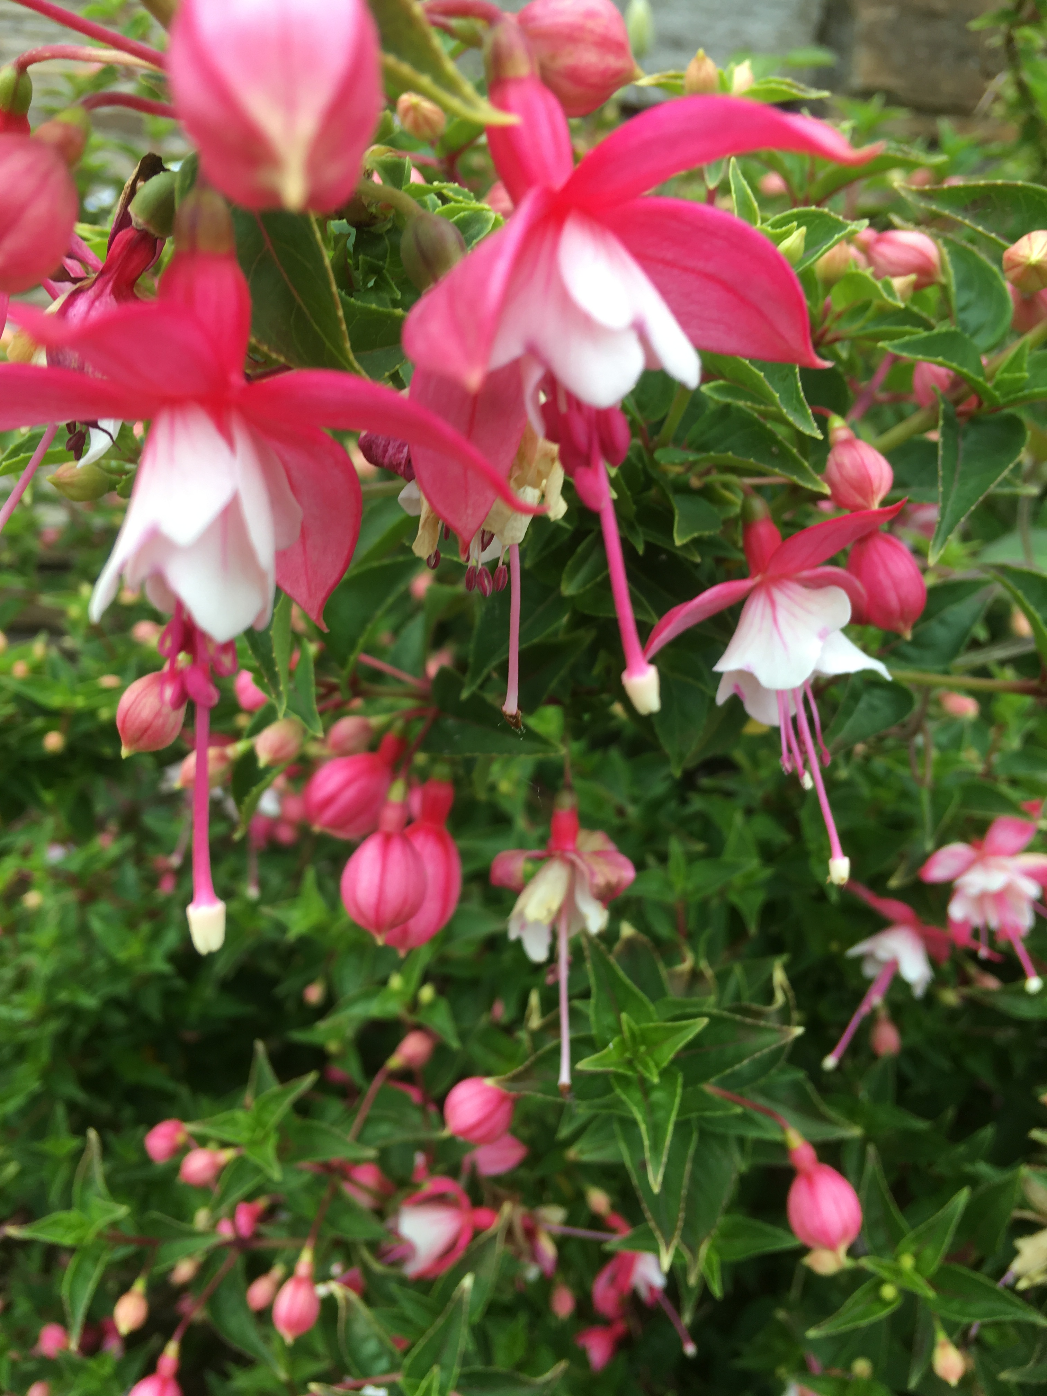
Nothing really matters except God but everything also matters because of God (Thomas Keating)
Heaven is a state of consciousness that the Beatitudes already manifest – as far as that is possible in this world. (Thomas Keating)

Slide 24
If the Beatitudes manifest a state of consciousness, then the absence of the Beatitudes must manifest a lack of consciousness, a lack of awareness. Such spiritual impoverishment allows homelessness seem to be an intractable problem, children to breakfast on a bag of crisps, the gap between rich and poor widen annually and single mothers, trapped in poverty, to remain among the most vulnerable and deprived in our society.

Slide 25
